Slide 1
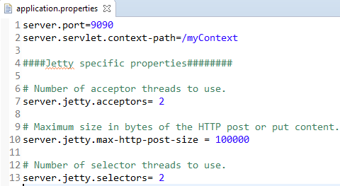
Spring Boot – Configure Jetty Options
To override, default jetty runtime configuration – you can configure them in application.properties file.

